Slide 1

Predicting Mortgage Approval Rates
Technical Report & Strategic Analysis
American University
Kogod School of Business KSB-621
December 2025

Slide 2
The Business Challenge
Business Question
How do social and economic characteristics affect mortgage lending approval rates in counties in the US?
Objective
Build a predictive model to identify US counties with high approval probabilities and characteristics associated with high approval likelihood.
Market Context
The recent high interests rate environment has created a challenging mortgage lending market.

Slide 3


Client Opportunity
Mortgage Lenders
Real Estate Developers
Non-Profits & Govt
Expanding branches, launching marketing campaigns, or target small business loan officers
Determine viability of new housing developments or investments
Consultation services on factors that would best improve mortgage rate approval.

Slide 4






Data Methodology
Robust Dataset
Geographic Scope and Time
Rigorous Cleaning
Loan Application Register (LAR)
Census American Community Survey data.
Aggregated by county level
10 States
Years 2019-2024 (excluding 2020)
20 million row and 800+ variables to 1,264 observations and 67 variables.
Split 70/30 for Training/Test

Slide 5
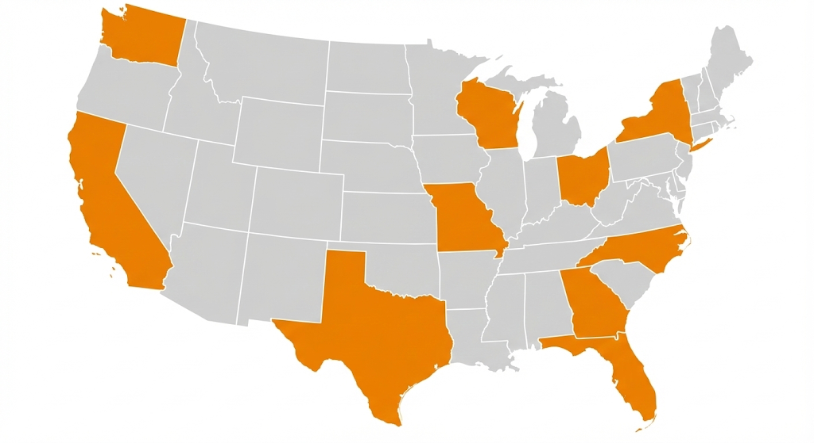
Geographic Scope
California
Florida
Georgia
Missouri
New York
North Carolina
Ohio
Texas
Washington
Wisconsin
Generated via AI: Gemini Pro

Slide 6
Variables
Dependent Variable:
Mortgage Percent Approval Rate (percent_approved)
Labor and Industry
Housing and Finance
Income and Poverty
Unemployment Rate
Percent Working from Home
Percent Working in Transportation
Percent in Manufacturing
Household Median Income
Percent with Mortgage
Gross Rent as percent of income
Percent on SNAP
Public Health Insurance
Percent below poverty line

Slide 7
Exploratory Insights
Var | Mean | SD | Min | Med | Max | Skew
Dep Var: Approval Rate | 78.2 | 5.7 | 48.1 | 78.4 | 93.3 | -.58
Bachelor Degree | 34.8 | 10.9 | 11.7 | 33.6 | 73.8 | .59
Grad Degree | 21.4 | 9.5 | 3.9 | 19.7 | 59.8 | 1.06
Married Households | 19.1 | 2.7 | 9.6 | 19.2 | 30.8 | .00
Median Income | 72,897 | 18,867 | 32,157 | 69,492 | 168,154 | 1.09
Poverty Rate | 11.6 | 4.1 | 3.2 | 11.2 | 36.9 | .99
Labor Force Part Rate | 61.7 | 5.8 | 20.8 | 62.6 | 73.7 | -1.35

Slide 8
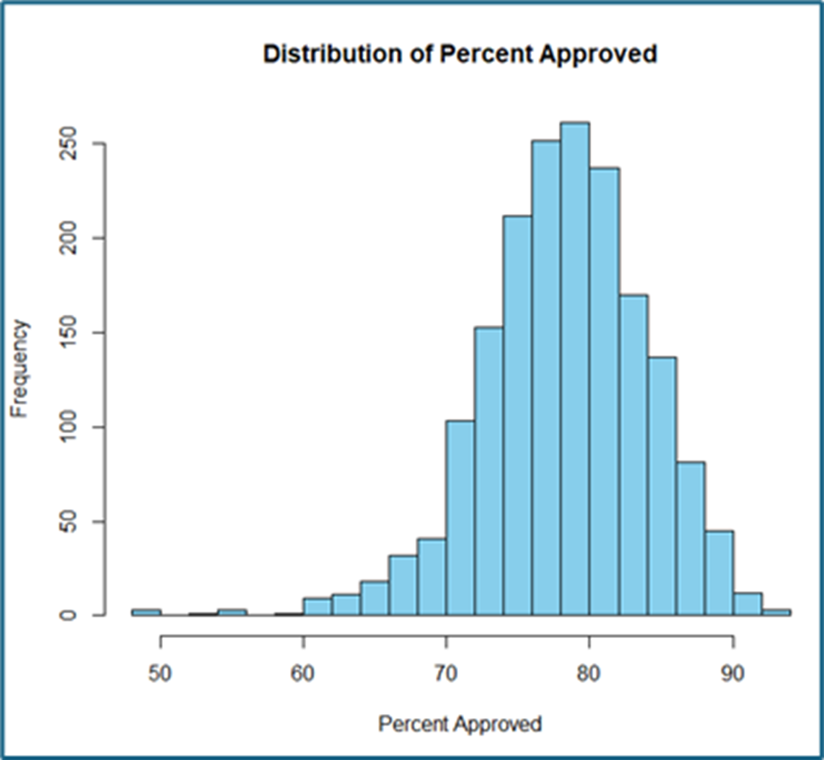
Exploratory Insights
Normally distributed (slight left skew)
Most counties are around 80% approval odds

Slide 9
Testing Assumptions
Autocorrelation
Heteroscedasticity
Multicollinearity
Durbin-Watson Test
Initial: 1.28 (High)
With Lag: 1.83 (Moderate)
Breush-Pagan Test
Failed
Variance is not constant.
CI and VIF Analysis
High

Slide 10
Model Selection
Linear Regression
Elastic
Elastic (Best Alpha)
LASSO
XGBoost
Ridge
Random Forest
Random Forest (Best Mtry)
XGBoost (No Lag)

Slide 11
Model Selection
Model | RMSE | MAE | Adjusted_R2
XGBoost | 2.739 | 2.126 | .724
Linear | 2.796 | 2.191 | .763
Elastic (best alpha) | 2.789 | 2.176 | .714
Elastic | 2.814 | 2.188 | .709
LASSO | 2.819 | 2.193 | .708
Ridge | 2.860 | 2.243 | .699
Random Forest | 3.212 | 2.607 | .621
Random Forest (Mtry) | 3.166 | 2.507 | .631
XGBoost NoLag | 3.214 | 2.487 | .621

Slide 12
XGBoost
Why the best model?
Lowest RMSE & MAE: best predictive accuracy
Multicollinearity: Handles well
Performs nonlinear modeling and interaction detection
Lag Variable: Allows model to capture year-to year economic dependencies

Slide 13
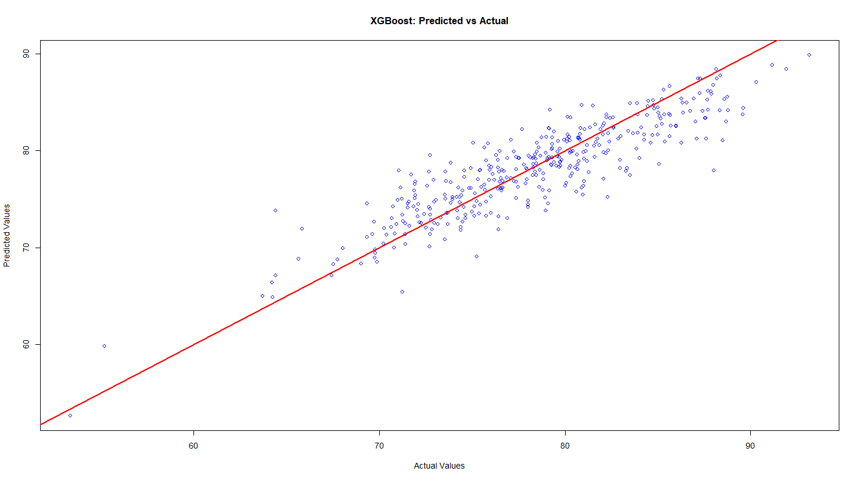
Predictive Accuracy
Visualizing Success
The scatter plot compares our model's Predicted Approval Rates against the Actual Rates.

Slide 14
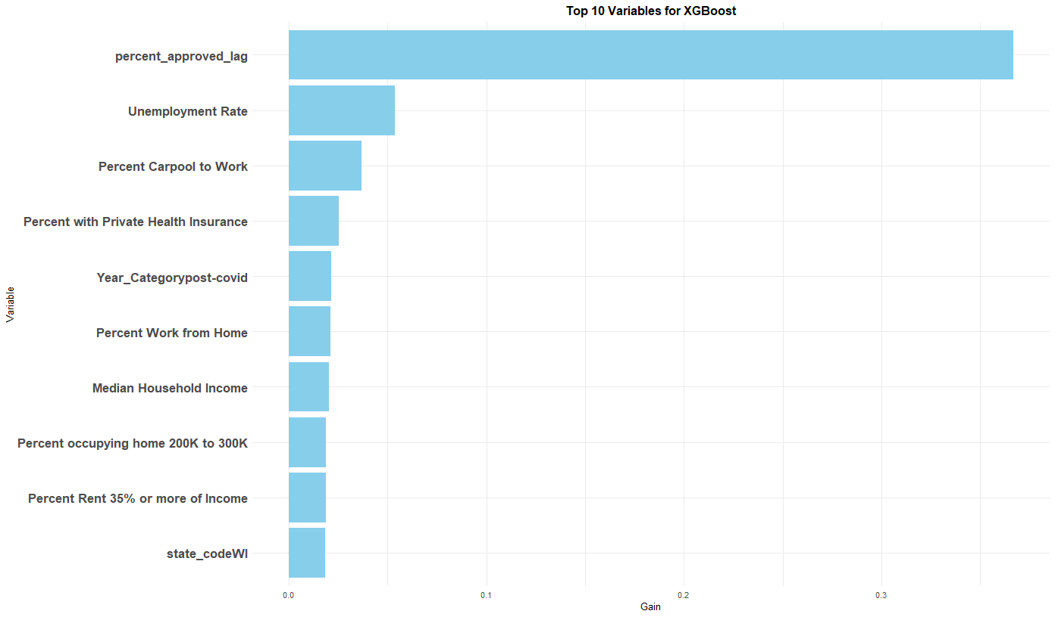

Primary Driver: Historical Momentum
The "Lag" Factor
Previous year's approval rate greatest predictor
Why this matters?
Economic conditions change slowly.

Slide 15
Underlying Economic Drivers
When we control for historical data (remove the lag variable), and run another XGBoost, the core economic fundamentals emerge as key predictors:
Private Health Insurance
Commuting Habits (Carpooling)
Unemployment Rate
Work from Home

Slide 16
Key Findings
Mortgage approval patterns are highly persistent across years
High-income, economically stable counties tend to show higher approval rates
Lag feature is the strongest single predictor
Counties with high unemployment and/or poverty show lower approval rates

Slide 17
Limitations
Our analysis had a few limitations:
Heavy reliance on lag variable
High multicollinearity
Dataset aggregated at county level

Slide 18

Strategic Recommendations
Target High-Probability Zones
Business Application
Advertise this model to loan officers and mortgage brokers. Increasing efficiency and reduce the cost-per-acquisition for new mortgages.
Identify counties with high historic approval rates and strong private insurance coverage.

Slide 19
Path Forward
Small Business Loan Officers
Good Will
Small Business Loan Officer subscribe to our model and gain insights into top counties or best counties in a state of new entry.
Provide key insights to non-profits to gain good will

Slide 20
Future Work
Model the borrower
Climate Data
Incorporate individual level factors to predict approval odds instantly.
Merge with Climate data to identify high-risk areas

Slide 21
Questions?
Analytic Avengers Team

Slide 22
Additional Slides

Slide 23
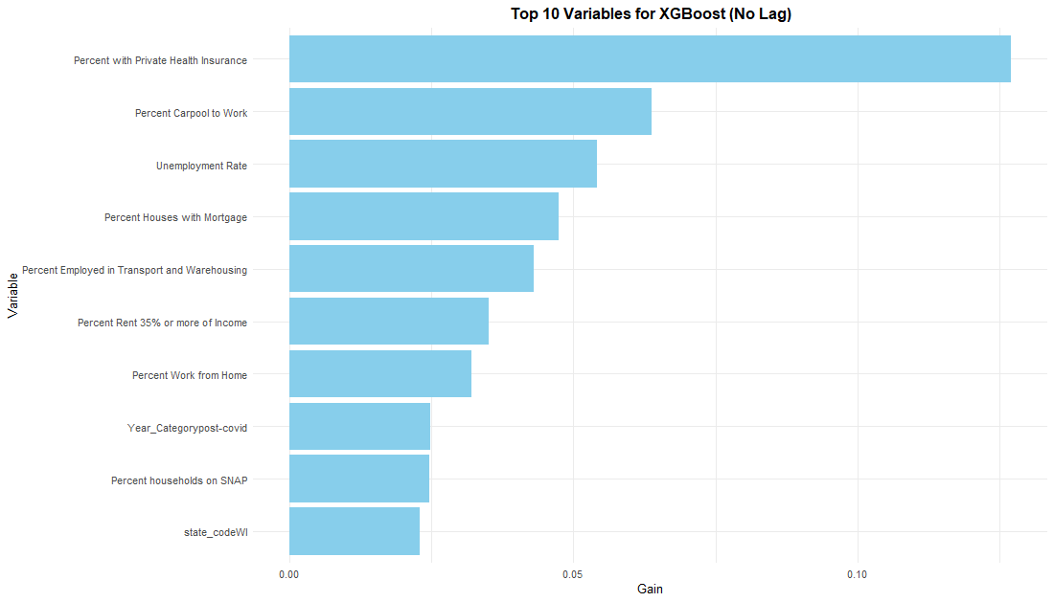
ADDITIONAL SLIDES

Slide 24
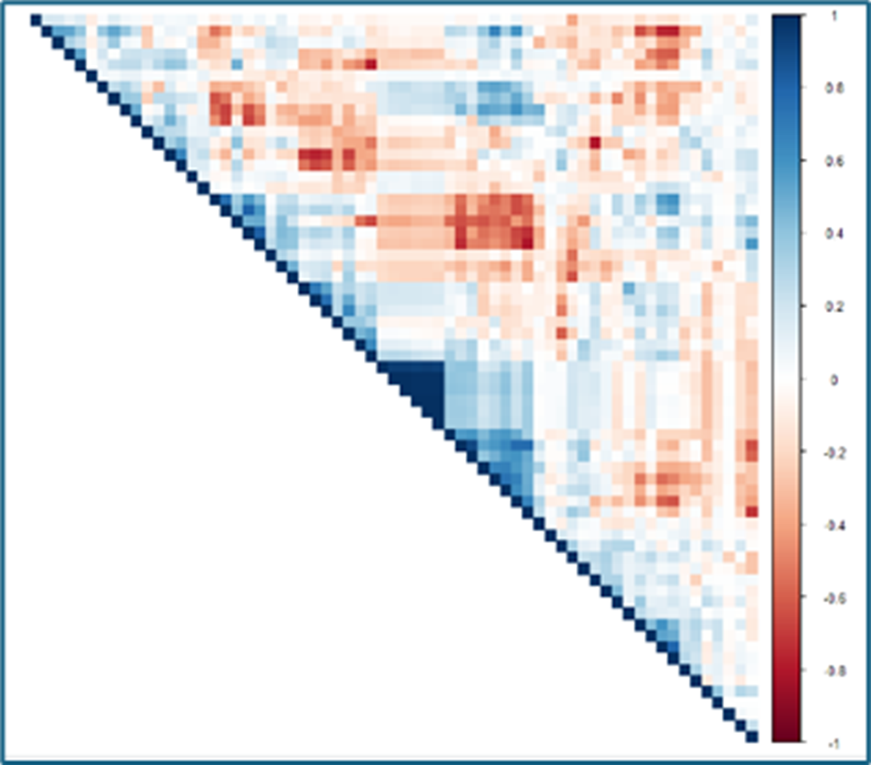
ADDITIONAL SLIDES - Multicollinearity
Strong multicollinearity among economic & demographic variables.
Durbin–Watson tests:
Without lag: DW = 1.28 → high autocorrelation.
With lag: DW = 1.84 → improved.
Breusch–Pagan test failed → heteroscedasticity present.
Residuals follow normal distribution.

